Slide 1

Genre-Based Book Recommendation System
NAME: AROOJ FATIMA
ROLL NO: 221503
SUBJECT: MACHINE LEARNING
PROJECT: SUPERVISED LEARNING

Slide 2

Problem Definition & Objectives
Problem Statement
Online book platforms struggle with personalized discovery. Traditional keyword searches are insufficient.
Solution
Design a genre-based book recommendation system using ML.
Why Machine Learning?
ML captures non-linear relationships, scales better than manual rules, and improves recommendations over time.
Objectives
Predict book relevance score using ML.
Recommend top-N books based on genre/title.
Compare and select best-performing ML model.
Real-World Impact
Applicable in online bookstores, digital libraries, and educational platforms.

Slide 3

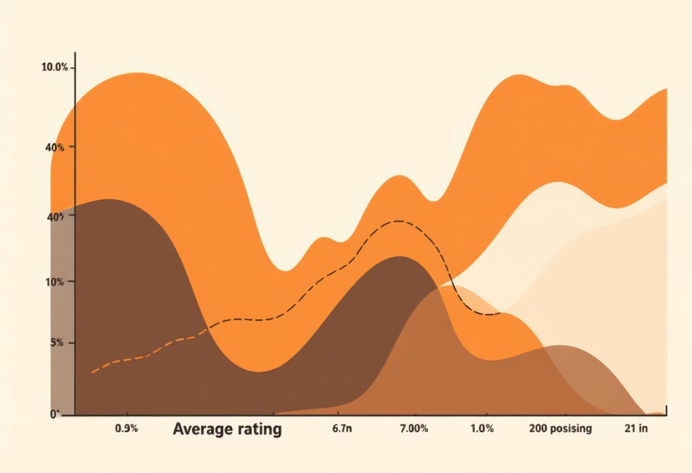
Dataset Overview
Target Variable: Relevance Score
This custom score balances book quality (rating) and popularity (number of ratings).
Source & Size
"Best Books (10k) Multi-Genre Data" from Kaggle, by Ishika Johari. Contains ~10,000 books with 7 features.
Features
Book: Title
Author: Author name
Description: Book summary
Genres: Categorical (multi-label)
Avg_Rating: Numerical (Goodreads)
Num_Ratings: Numerical
URL: Goodreads link

Slide 4




Data Cleaning & Preprocessing
Missing Values
Text fields replaced with empty strings; numerical fields verified.
Duplicate Records
Removed duplicate book titles to ensure unique recommendations.
Encoding & Transformation
Genres: MultiLabelBinarizer
Descriptions: TF-IDF vectorization
Dimensionality: Truncated SVD

Slide 5
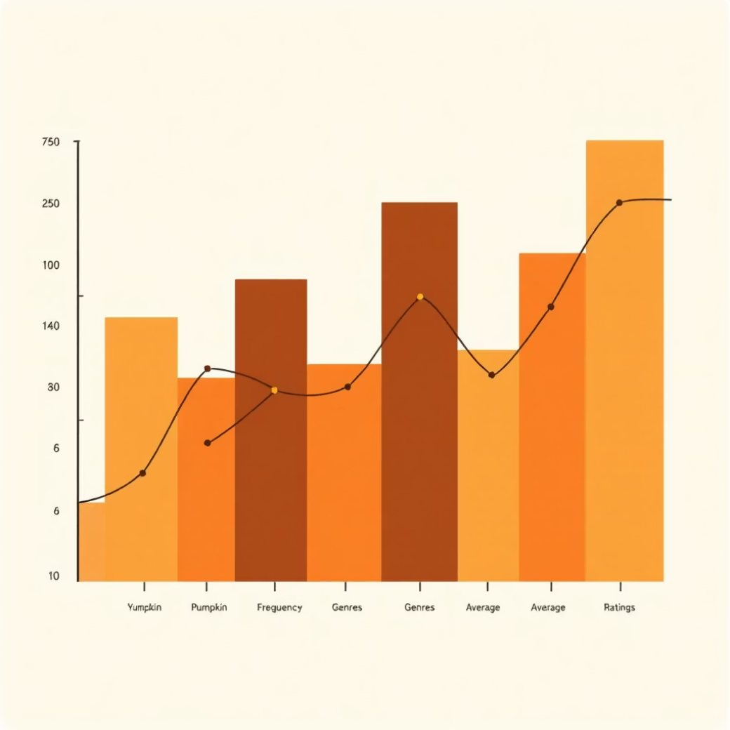

Data Visualization & Feature Engineering
Exploratory Data Analysis (EDA)
Histogram of Avg_Rating
Boxplot of Num_Ratings
Genre frequency bar chart
Key Insight
Popularity and ratings positively influence recommendation relevance.
Engineered Feature: Relevance Score
Relevance Score = Avg_Rating + log(Num_Ratings + 1).
This prevents bias towards only high-rating or only popular books, improving ranking quality.

Slide 6



Model Training
Linear Regression
Random Forest Regressor
Gradient Boosting Regressor
Purpose: Baseline model.
Purpose: Ensemble learning. Hyperparameters: n_estimators = 200, max_depth = 20.
Reason: Simple, interpretable. Limitation: Cannot capture non-linear patterns.
Purpose: Boosted ensemble. Hyperparameters: n_estimators = 150, learning_rate = 0.1.
Advantage: Handles non-linear interactions.
Advantage: Strong performance with structured data.

Slide 7
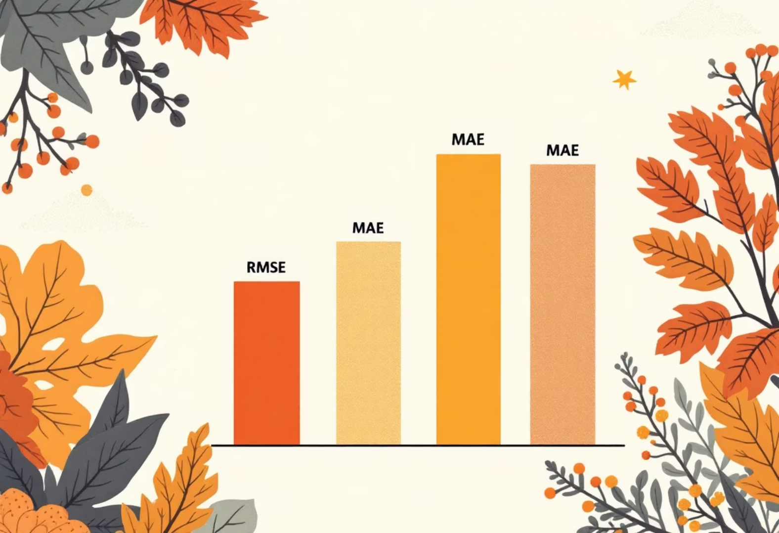
Model Evaluation & Results
Evaluation Metrics (Regression Task)
Metrics
RMSE
MAE
R2
RMSE (Root Mean Squared Error)
Linear Regression
0.148470
0.114922
0.860879
MAE (Mean Absolute Error)
R2 Score (Coefficient of Determination)
Random Forest
0.027575
0.008853
0.995201
Gradient Boosting
0.020052
0.014287
0.997462
Best Model: Gradient Boosting Regressor
Lowest error, stable predictions, captures complex patterns, and efficient for deployment.

Slide 8

Error Analysis & Deployment Concept
Error Analysis
Errors mainly occur for niche genres with limited data
Less accurate for books with very few ratings
Limitations
The current system recommends based on genre/title similarity alone. This results in generic recommendations rather than personalized ones.
Newly published books with no ratings or minimal data cannot be effectively recommended until they accumulate sufficient user engagement and ratings.
Deployment Concept
The TF-IDF vectorization of book descriptions is only as good as the descriptions themselves. Poor, vague, or missing descriptions lead to weak feature representations and inaccurate recommendations.
01
Frontend: Streamlit
Future Improvements
User selects genre or title.
Add collaborative filtering
02
Incorporate user feedback
Backend: Trained ML Model
Use deep learning embeddings (BERT)
Input processed, ML model predicts relevance.
Add multilingual support
03
Output
Top-N books displayed with covers.

Slide 9



Conclusion
This project successfully demonstrates an end-to-end machine learning pipeline, covering data preprocessing, feature engineering, multiple model training, evaluation, and deployment planning.
Ensemble methods outperform simple linear models for recommendation tasks, providing robust and accurate book suggestions.

